Slide 2
Accelerating FFF Printing via Viscous Heating
EXPERIMENTAL FINDINGS AND PREDICTIVE ALGORITHMS
Tim A. Osswald
Allen Jonathan Román

Slide 3
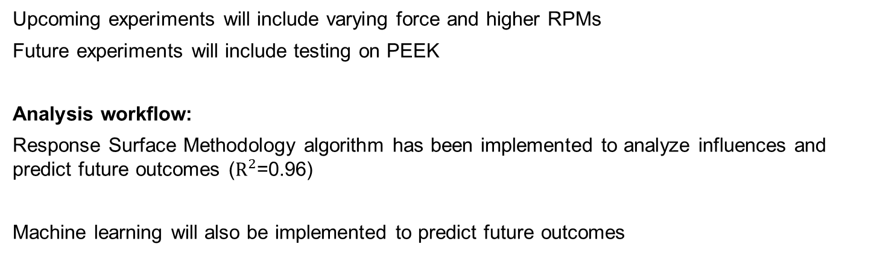
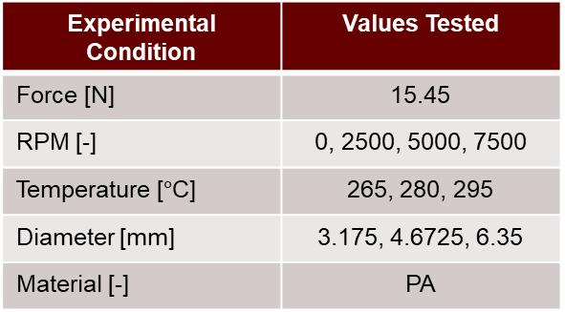
Completed workflow
Experiments conducted to date:
Experimental Condition | Values Tested
Force [N] | 15.45
RPM [-] | 0, 2500, 5000, 7500
Temperature [$°$C] | 265, 280, 295
Diameter [mm] | 3.175, 4.6725, 6.35
Material [-] | PA
Upcoming experiments will include varying force and higher RPMs
Future experiments will include testing on PEEK
Analysis workflow:
Response Surface Methodology algorithm has been implemented to analyze influences and predict future outcomes ($R^{2}$=0.96)
Machine learning will also be implemented to predict future outcomes

Slide 4
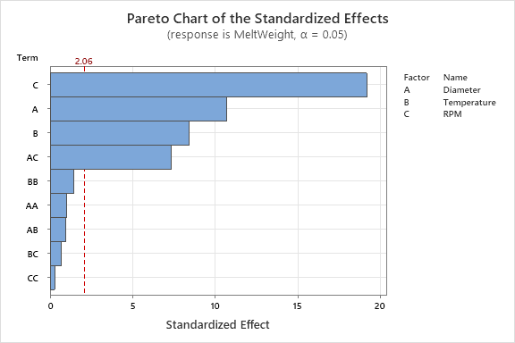
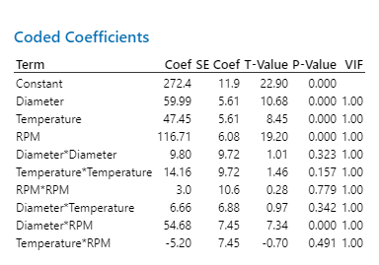
Response Surface Method – Pareto Chart
The magnitude of the standardized effects explains which coefficients have the most influence on the response, melting behavior.
Anything to the right of the red line is statistically significant
Pareto Summary:
Rank of input influences
  RPM > Diameter > Temperature
The interacting influence of Diameter-RPM is highly influential
Coefficient Summary:
Coefficients in green agree with Pareto analysis
  RPM > Diameter > Temperature

Slide 5
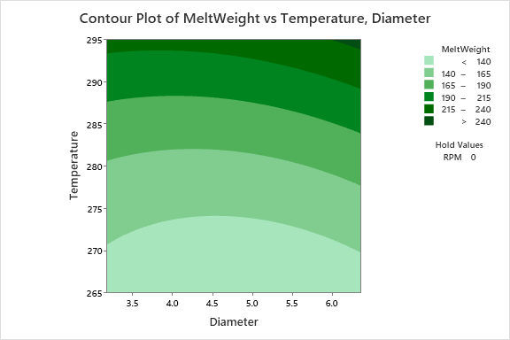
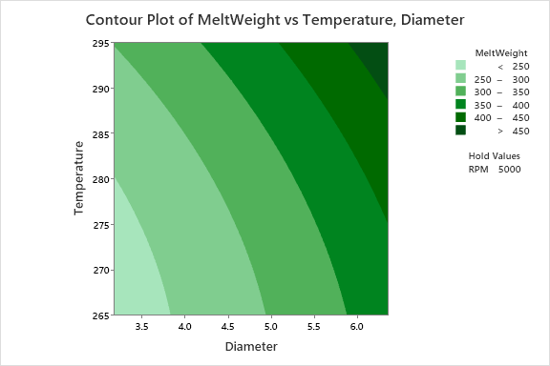
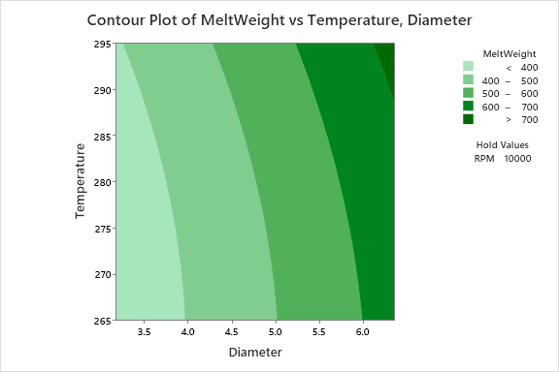
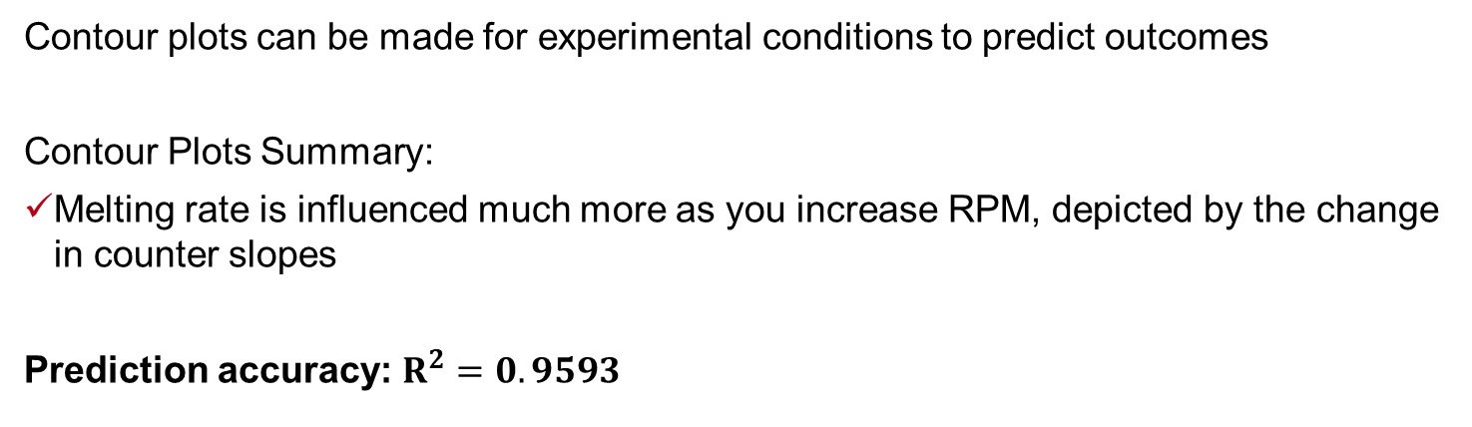
Response Surface Method – Contour Plots
Contour plots can be made for experimental conditions to predict outcomes
Contour Plots Summary:
Melting rate is influenced much more as you increase RPM, depicted by the change in counter slopes
Prediction accuracy: $R^{2}=0.9593$
0 RPM
5000 RPM
10,000 RPM

Slide 6
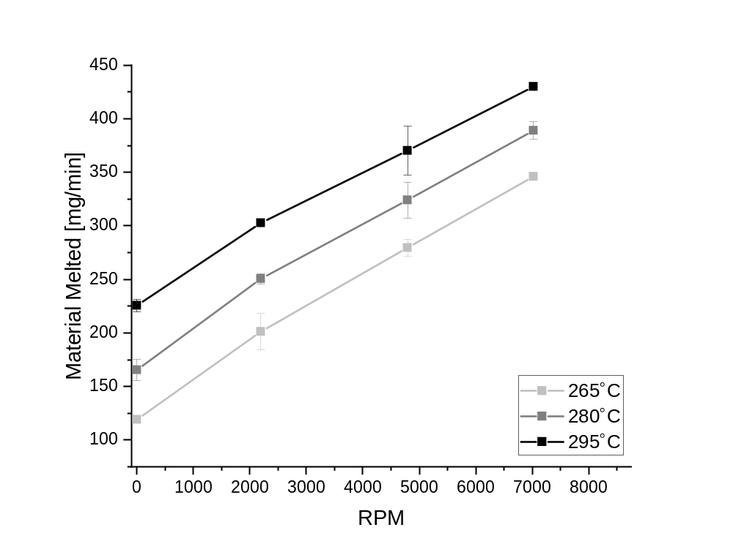
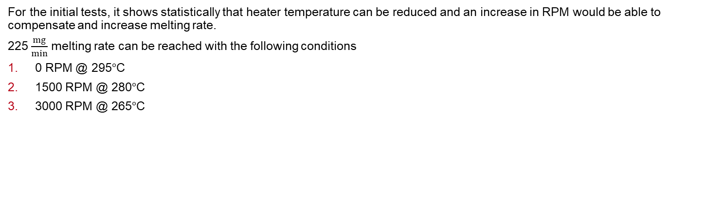
Response Surface Method – Conclusions
For the initial tests, it shows statistically that heater temperature can be reduced and an increase in RPM would be able to compensate and increase melting rate.
225 $\frac{mg}{min}$ melting rate can be reached with the following conditions
0 RPM @ 295$°$C
1500 RPM @ 280$°$C
3000 RPM @ 265$°$C
Diameter = 4.6725 mm

Slide 7
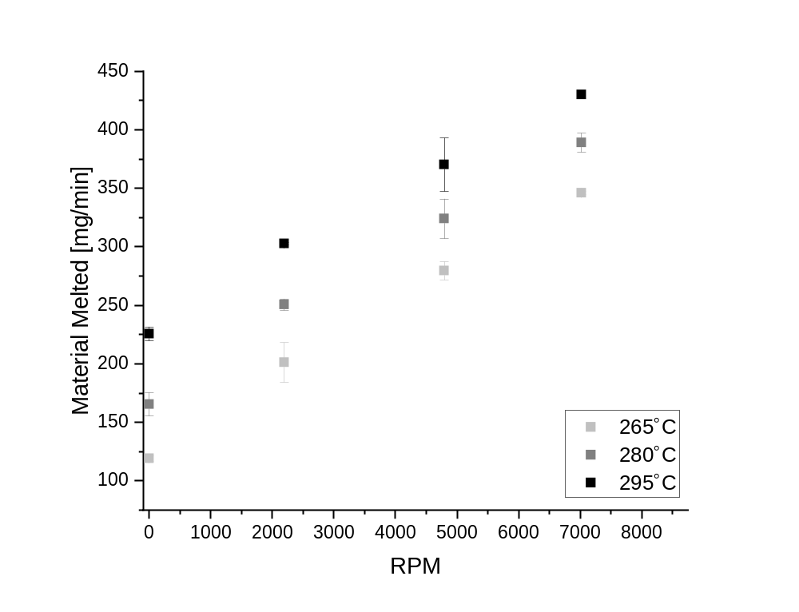
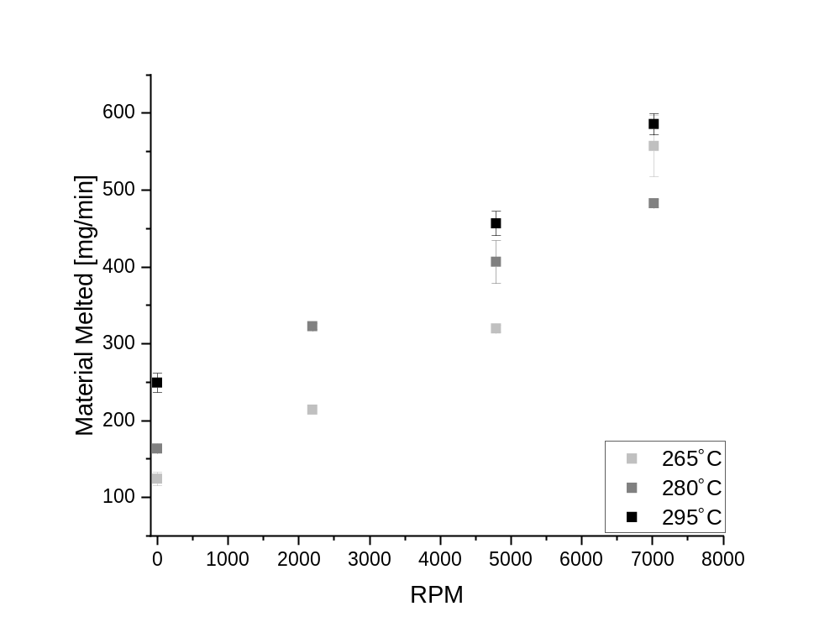
Influence of Filament Diameter on Viscous Heating
Diameter = 4.6725 mm
Diameter = 6.35 mm

Slide 8
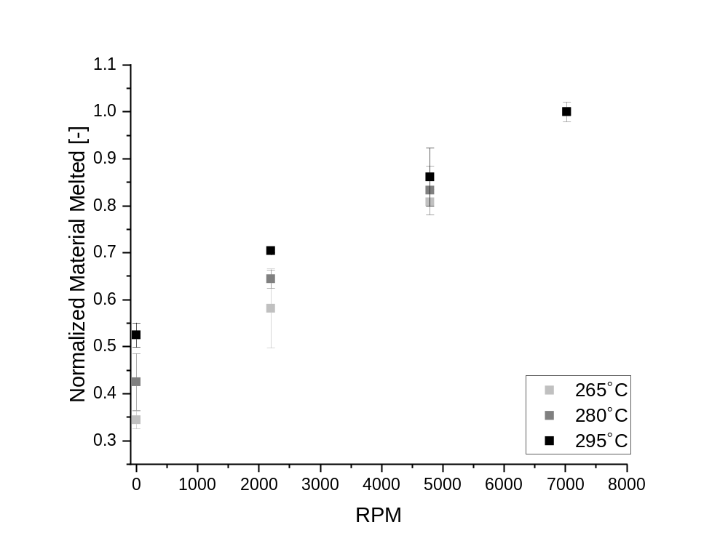
Influence of Filament Diameter on Viscous Heating
Diameter = 4.6725 mm
Normalized

Slide 9
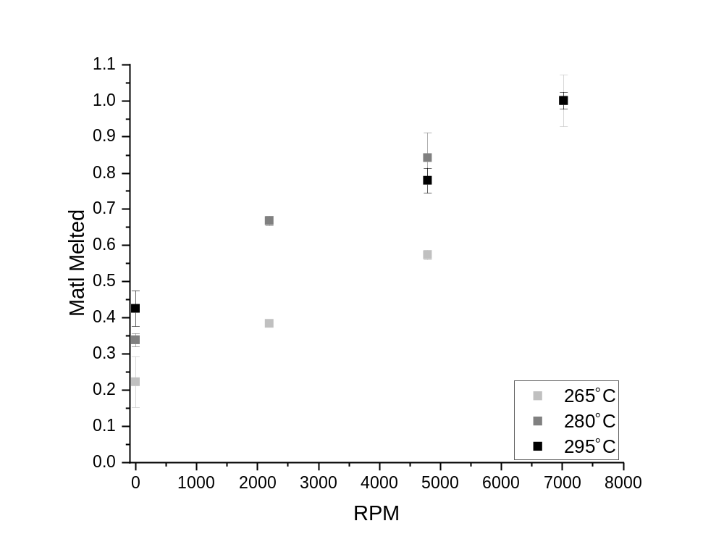
Influence of Filament Diameter on Viscous Heating
Diameter = 6.35 mm
Normalized

Slide 10
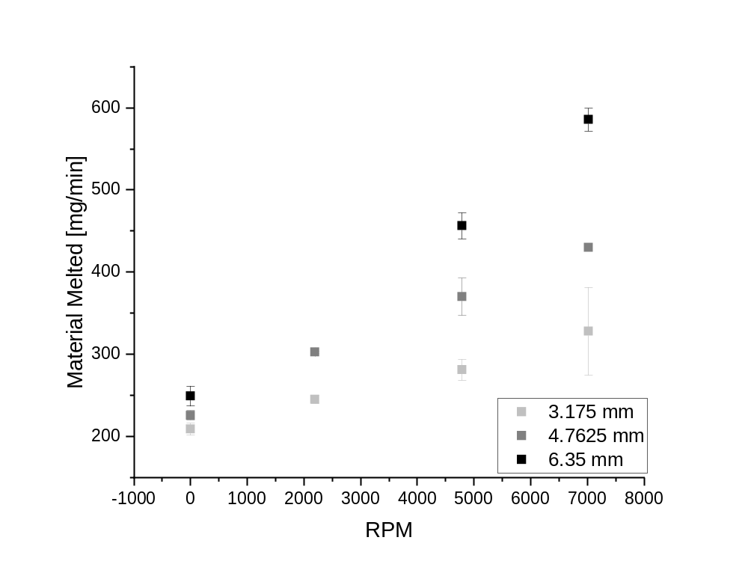
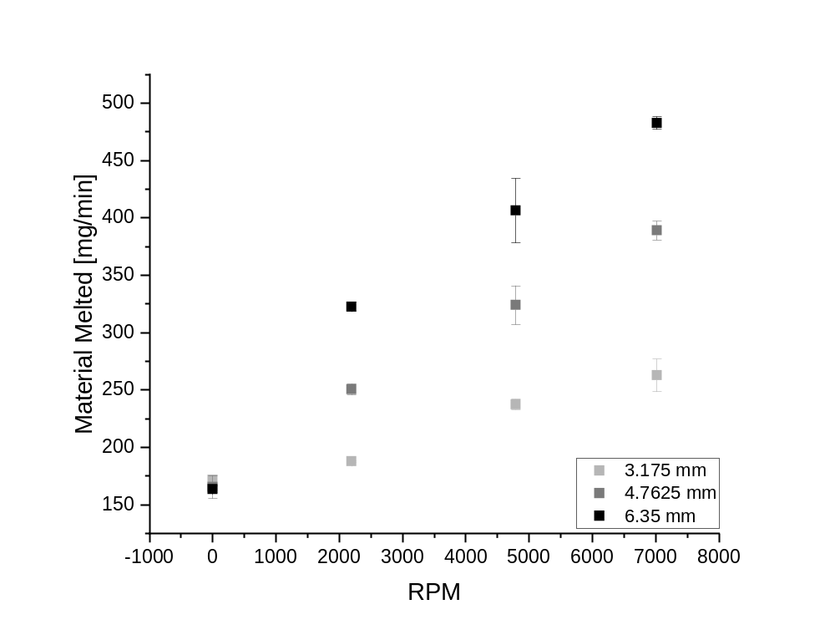


Influence of Temperature on Viscous Heating
280$°$C
295$°$C

Slide 11
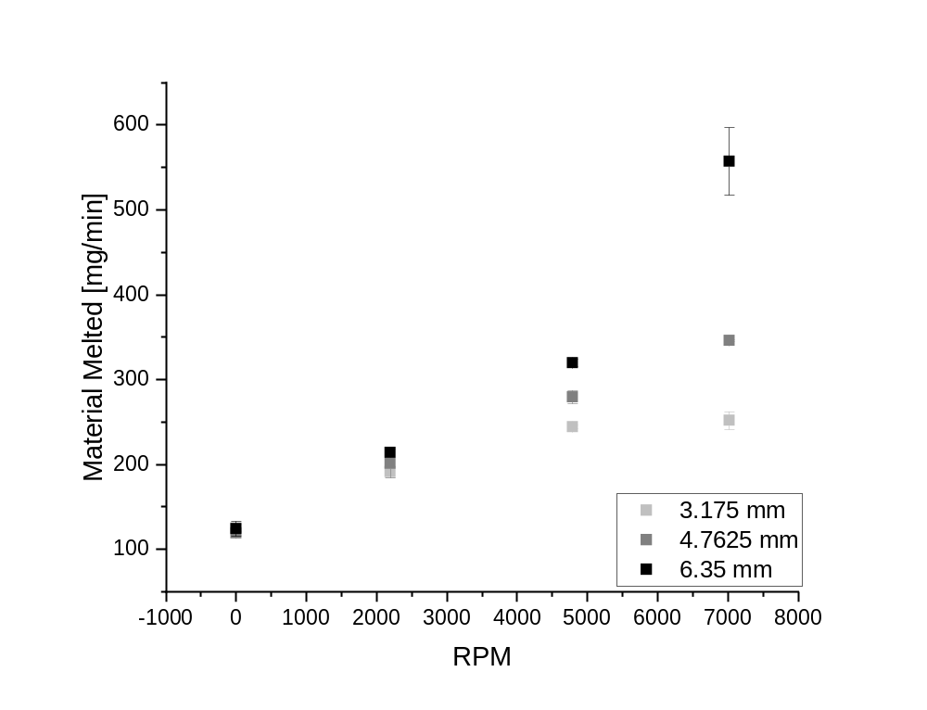
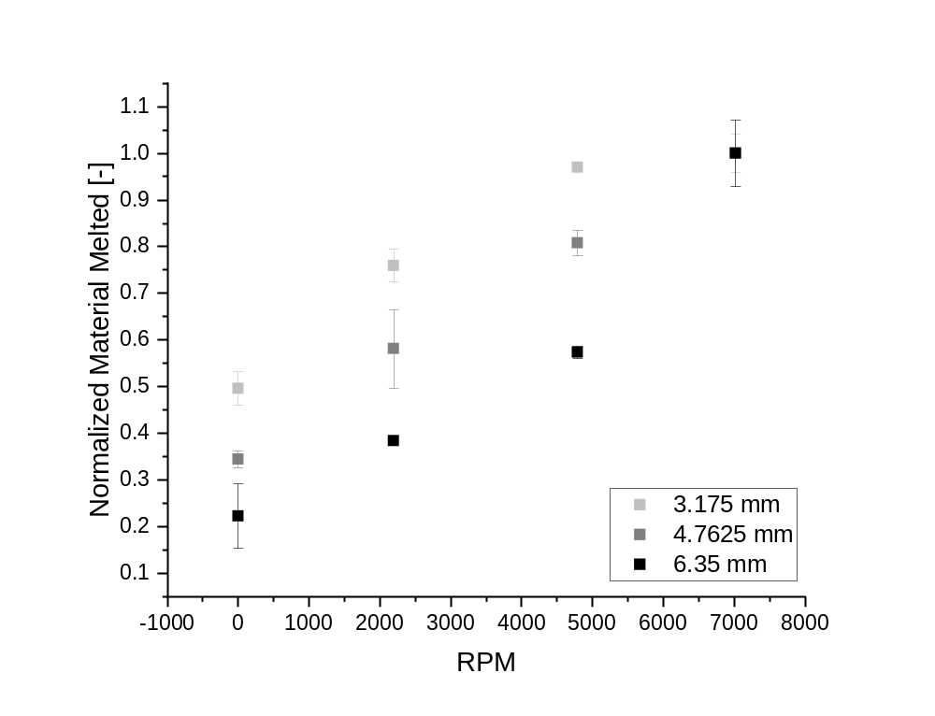

Influence of Temperature on Viscous Heating
265$°$C
Normalized

Slide 12
Accelerating FFF Printing via Viscous Heating
PROTOTYPE DESIGN WORK
Tim A. Osswald
Allen Jonathan Román

Slide 13
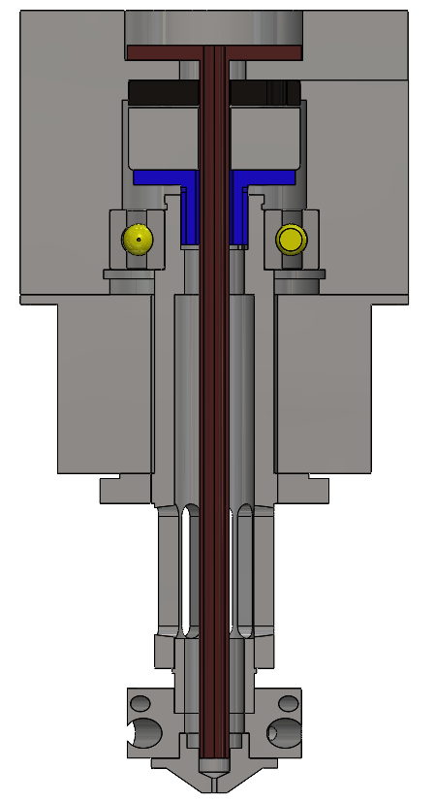
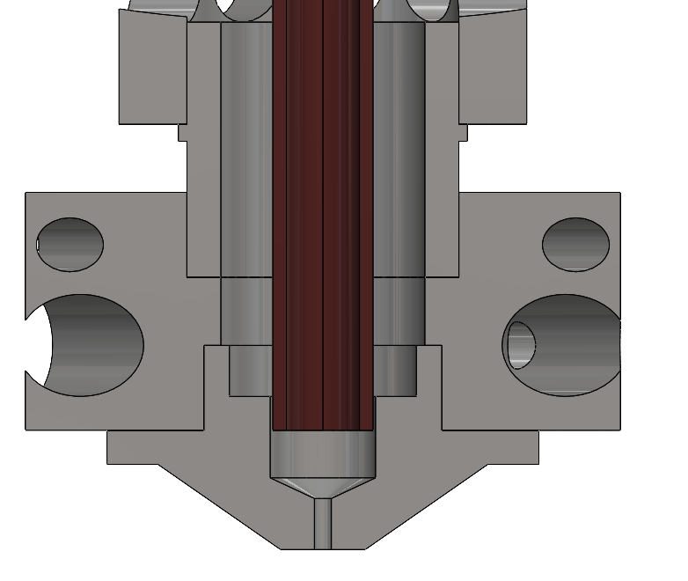
Preliminary Prototype Design

Slide 14
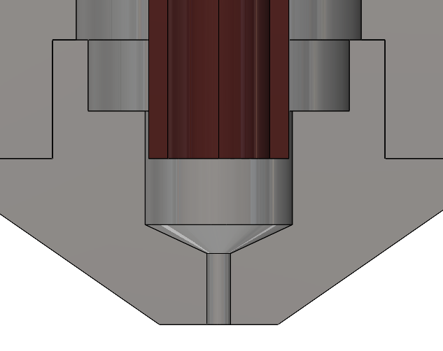
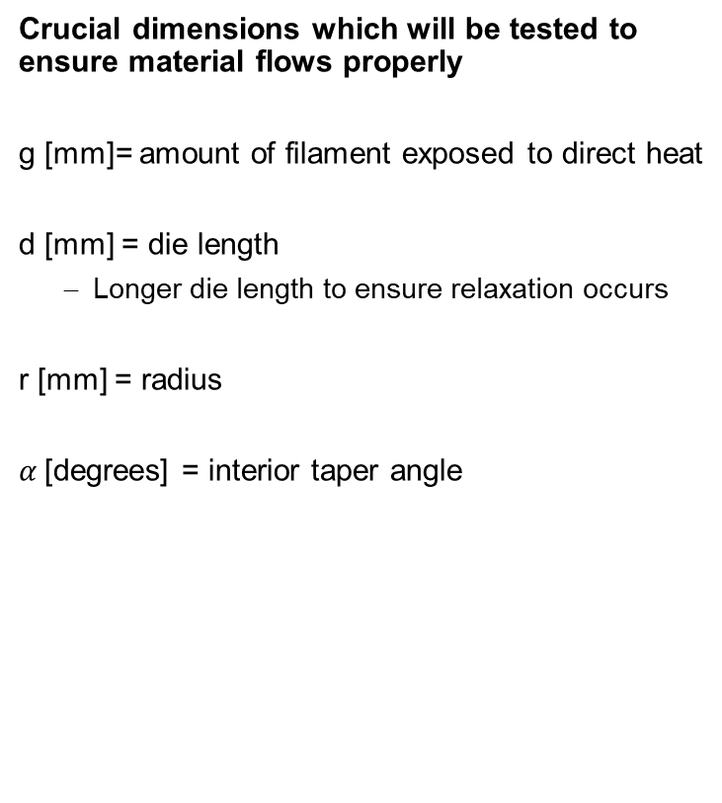

Crucial Dimensions of Prototype
Crucial dimensions which will be tested to ensure material flows properly
g [mm]= amount of filament exposed to direct heat
d [mm] = die length
  Longer die length to ensure relaxation occurs
r [mm] = radius
$α$[degrees] = interior taper angle
g [mm]
r [mm]
$α$ [degrees]
d [mm]

Slide 15






Crucial Dimensions of Prototype
Crucial dimensions which will be tested to ensure material flows properly
Issues to avoid with solutions:
Centrifugal forces to not allow proper extrusion
  Possible solution: Area highlighted in green will be threaded to act as a conveying screw. Additionally, guide tube will be counter-rotating to create positive pressure zone to ensure material does not go up.
Material will not have enough time to relax, resulting in extrusion defects
  Possible solution: Test various capillary lengths to ensure smooth extrudate
g [mm]
r [mm]
$α$ [degrees]
d [mm]

Slide 17
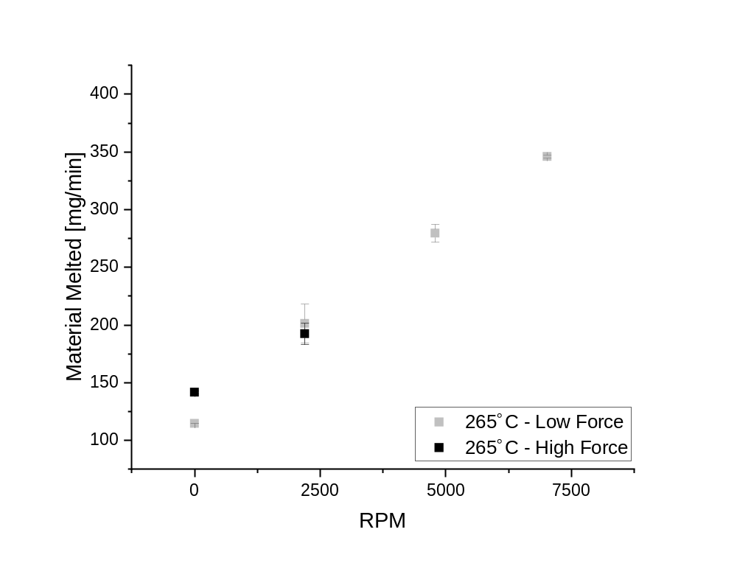
Medium Diameter

Slide 18
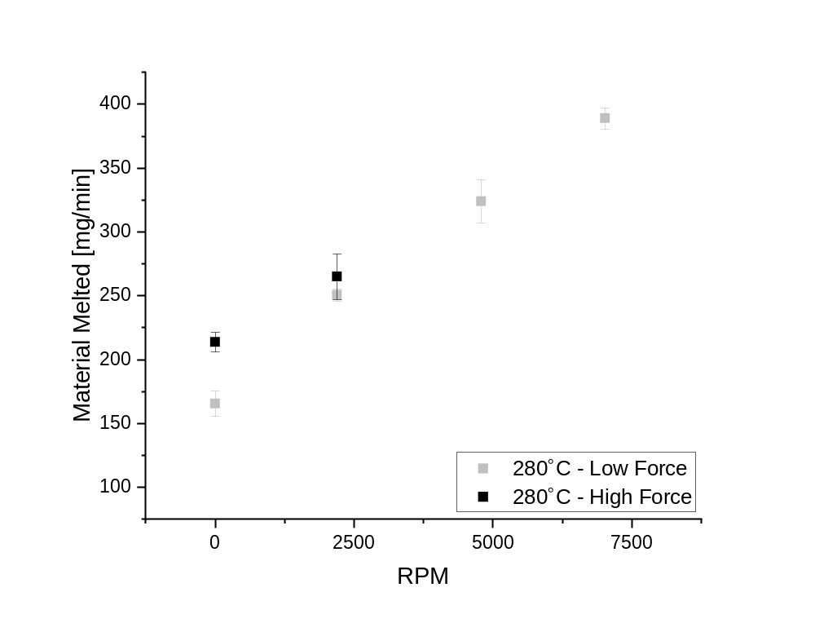
Medium Diameter

Slide 19
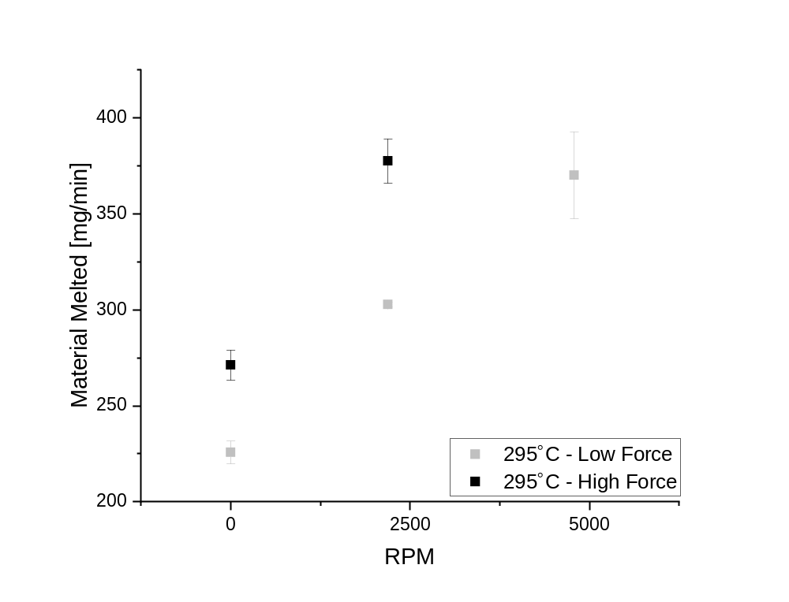
Medium Diameter

