Slide 2
Accelerating FFF Printing via Viscous Heating
WARF Accelerator
Tim A. Osswald
Allen Jonathan Román

Slide 3
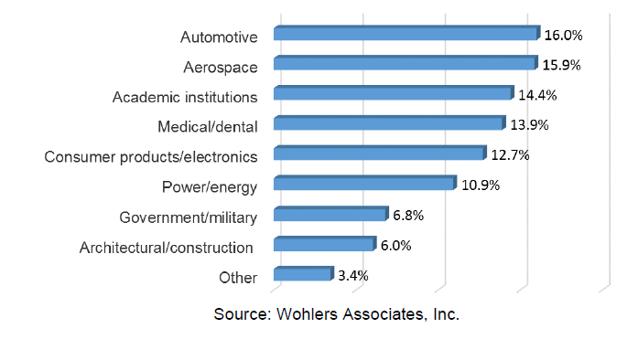
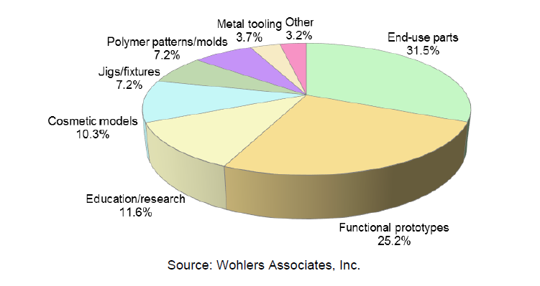
Implementation of Additive Manufacturing (AM) within industry
How organizations currently use industrial AM systems.
  Prototyping
  Tooling
  Final part production
  Education/research
Wohler’s Report 2021

Slide 4
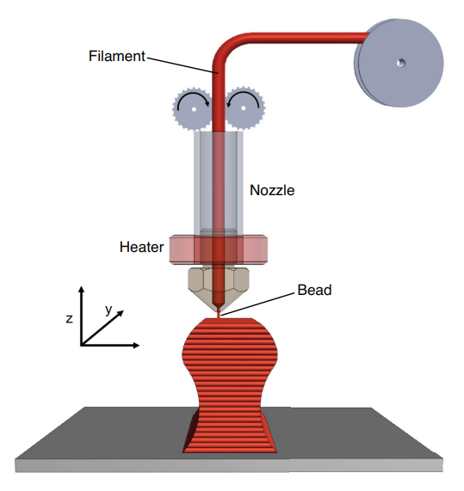
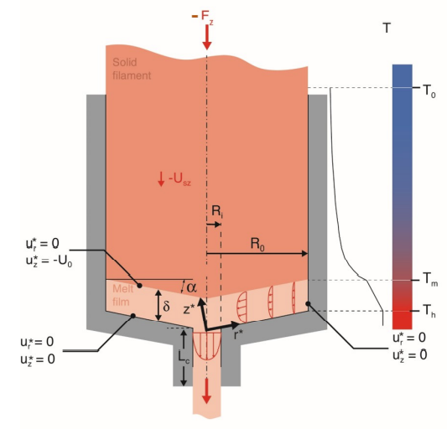
Traditional Fused Filament Fabrication (FFF) process

Slide 5
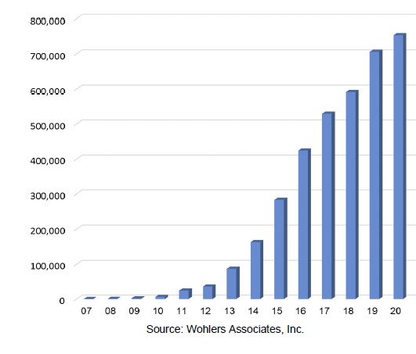

Current market for desktop 3D printers
Average annual growth rate of worldwide revenues produced by all AM products/services from 1988 to 2020 = 26.1%
  From years 2016 to 2020 = 20.8%
Desktop 3D printers have experienced astounding growth since 2012
$$\frac{Units sold}{year}$$
Wohler’s Report 2021

Slide 6
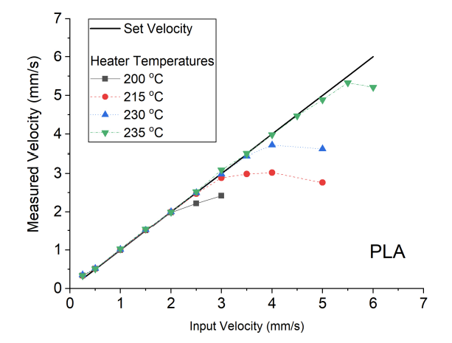
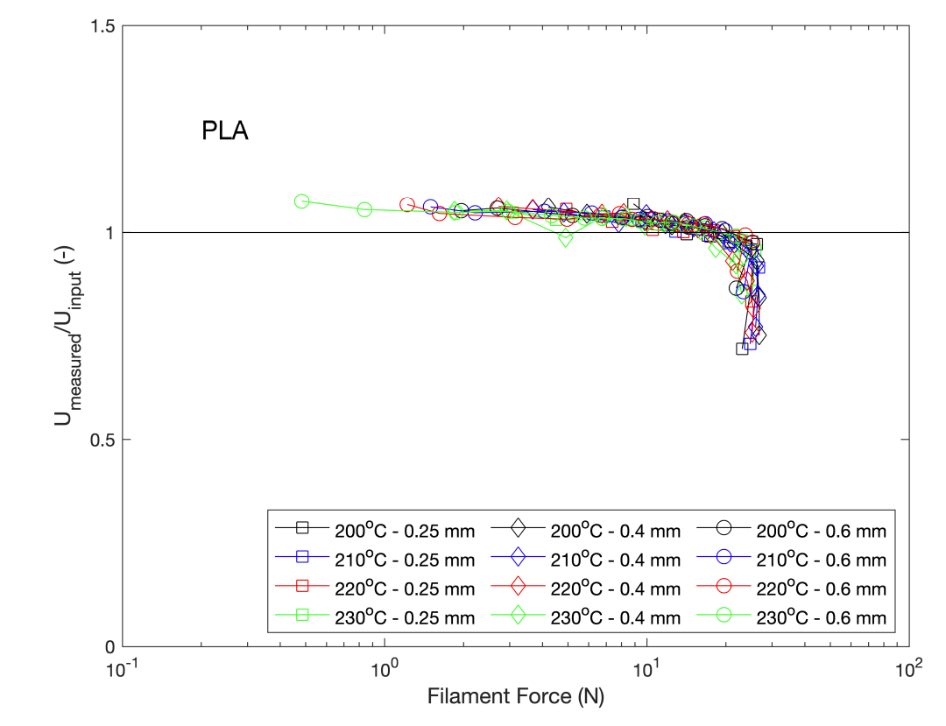
Bottleneck of FFF
Faster print speeds are attainable with larger forces imposed on filament
  High pushing forces may lead to slippage between gears and filament, causing disruptions to print. (Fig. 1 and 2)
  The filament pushing mechanism is limited to the material mechanical properties: buckling failure
The speed at which parts can currently be printed do not allow for industry to fully embrace FFF for production.

Slide 7
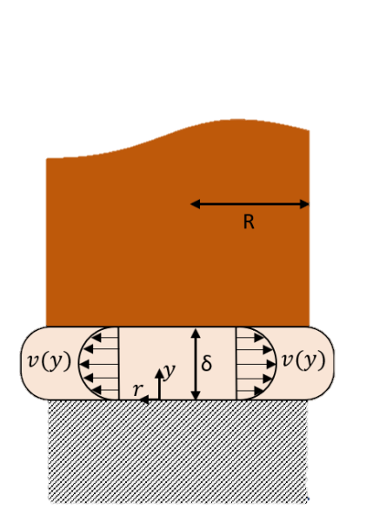

Proposed solution to accelerate melting
Rotation around filament introduces viscous heating,
Viscous heating allows for:
  Improved melting speed for the same given force
  Improved melting efficiency
Patent submitted
F

Slide 8
Proposed project milestones
Understand the influence rotation around the filament has on the melting speed
Understand the influence force and rotation has on the melting speed
Understand the influence filament diameter has on melting speed
Understand viscous heating has on energy consumption during printing

Slide 9



Preliminary experiments – Proof of concept
Concept: Melt plastic rod of varying diameters at various rotational speeds
Observation: Amount of melted material
Material: PA 101
  Diameter: 3.175 mm, 4.6725 mm and 6.35 mm
Rotational speed range: 0 RPM – 7250 RPM
Normal Stress on Rod ($σ$)
Rotational Speed ($ω$)
$$T_{bed}=280°C$$

Slide 10
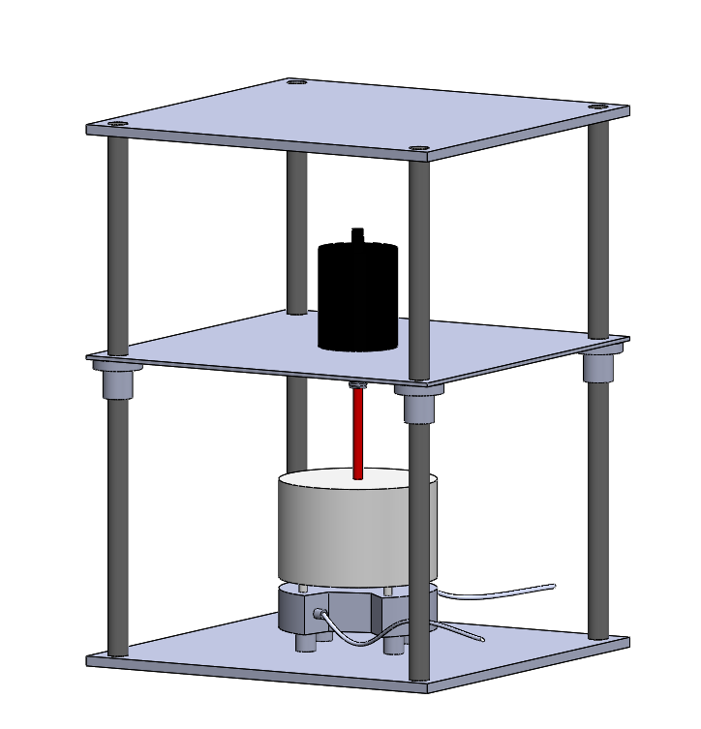
Experimental set up
CNC router motor
Filament
Guide for filament
Heated bed

Slide 11
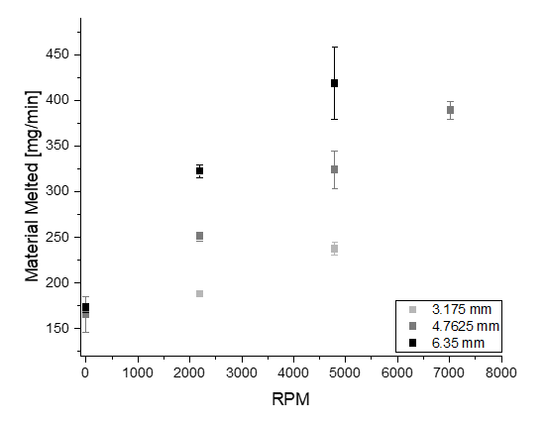
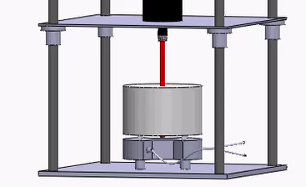
Preliminary study results
Larger RPM = More melting
Larger filament diameter = More melting
Force = 15.45 N

Slide 12
Future plan – Existing set up
Upgrade current experimental set up to eliminate variations due to vibration
  Reach 20,000RPMs
Study the influence of printing forces on print speeds with rotation
Conduct study on other materials

Slide 13

Commercialization Capabilities
Even with low production times, desktop 3D printer sales continually increase at a rapid pace
Decreasing printing time with a viscous heating system would ultimately increase attention.
Average Price of Hobbyist FFF 3D Printer = $1,000
~$750 Million
$$\frac{Units sold}{year}$$

